Slide 1

Complaint
Complaint
Redressal System

Slide 2


Group 8
Team Members:
Name of Team Mates Employee ID
Aayan Singh 2528689
Srivathsan Sridhar 2530833
Sree Hare M I 2528552
Z Abdul Latiff 2530193
Deepak Mishra 2530375
Naveen 2530559
Aarthiyan MR 2527521
Banoth Abhishek 2529846
Saranraj V 2530011

Slide 3



1.Introduction
2.Functional requirements
3.Tools and technologies
4.Architecture
5.Flowcharts
6.Implementation images
7.Testing images
Table of contents

Slide 4
Introduction:- Online complaint redressal system provides an online way of solving the problems faced by customers by saving time. The proposed complaint redressal system will be capable of taking care of the following activities:- 1) Customer can post the complaints in the site and get them solved in a specified time and can also know the status of the complaint he has raised. 2) Alert the concerned higher authority in case of escalation. 3) The customer can enquire about the status of the application at any time.

Slide 5





Objective
ABC Telecom Ltd. is one of India’s major telecommunication service providers offering landline, mobile phone and Fiber optic broadband services across the country. Their customer services group is interested in providing a set of customer redressal services through the development of a new application.
Our objective is to create a dynamic and responsive Java Complaint Redressal System web application for online complaint management system where the customers can raise complaints regarding their landlines and broadband services.
They want to have an online complaint management system where the customers can raise complaints regarding their landlines and broadband services.

Slide 6

Functional Requirements
Home
Admin
Customer
Manager
Engineer
Feedback

Slide 7

Customer Requirements
1.Raise or create a complaint
2.View complaints
3.Tracking the complaint
4.Providing feedback on the resolution of the complaint through the web UI.
5.The feedback provision is an optional feature.
6. Customers should provide the following minimal details such as name, address (with PIN Code), telephone / mobile number, type of problem (cannot make a call, but receive a call or can make calls, but cannot receive calls, or neither make nor receive calls).
7.Once successfully submit the complaint, a ticket is raised and shared it with the customer.
8.At that time, the status of the ticket will be ‘RAISED

Slide 8

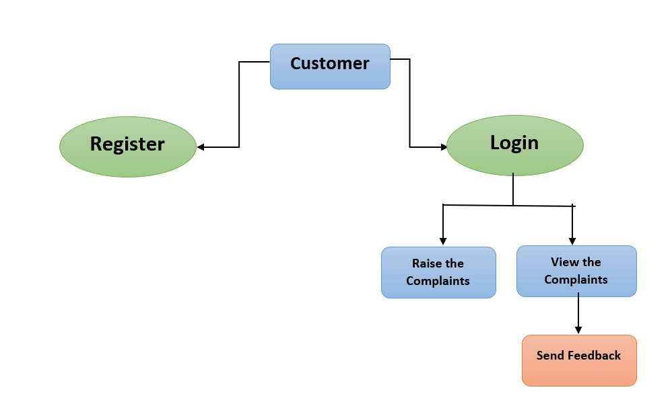
Customer flowchart

Slide 9
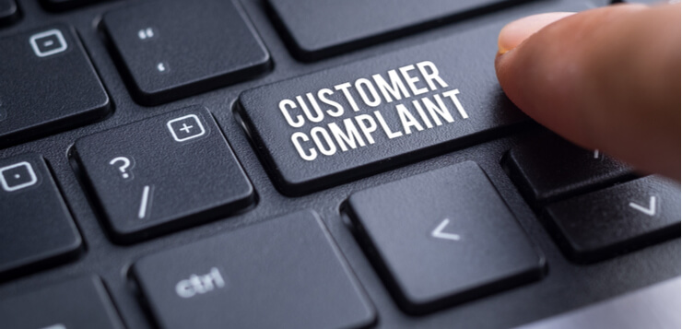

Complaints
Here the complaints register by the customer will be stored in the database.
It consists of customer email, pin code, complaint and status.
Here the status will be updated by the engineer part and the customer can view the updated status
Ticket id will also be generated one after successful complaint registration by the customer.

Slide 10

Feedback
Here the customer can add the feedback
Feedback table is created and it consists of ticket id and customer details
The feedback must be able to see by both the engineer and the manager.
Engineers can speed up their work according to the customers feedback components.

Slide 11

Manager Requirements
Once the manager has been logged in, he is able to see the complains which has been assigned at his pincode.
He can assign the task to any engineer in order to solve the customer’s issue.
He/she is able to see the feedbacks given by customers.

Slide 12

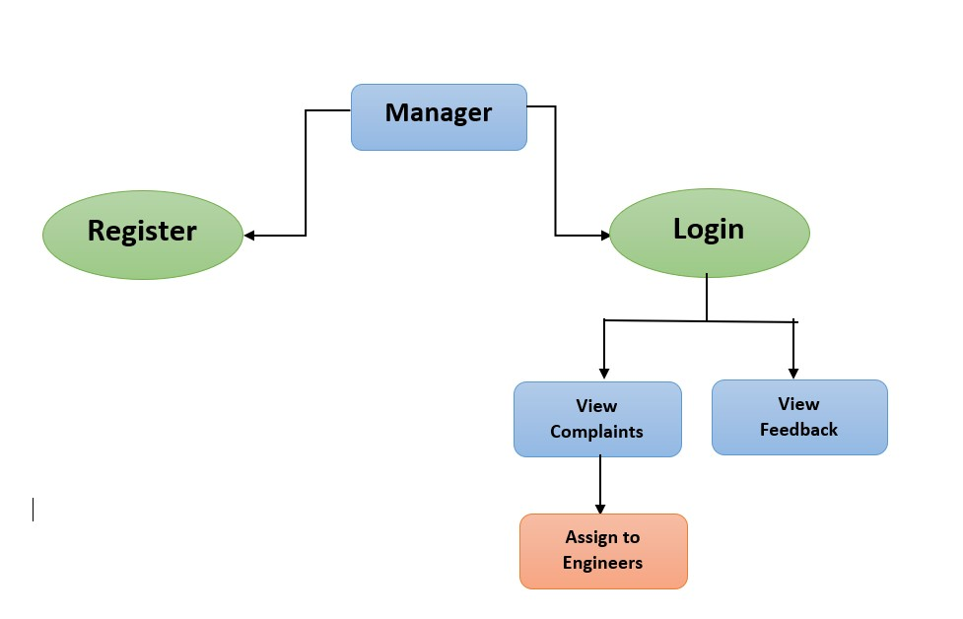
Manager flowchart

Slide 13

Engineer Requirements
Once the engineer has been logged in, he is able to see the complains which has been assigned to him by the manager.
Depending on the current status of work he/she can update the status.
He/she is able to see the feedbacks given by customers.

Slide 14

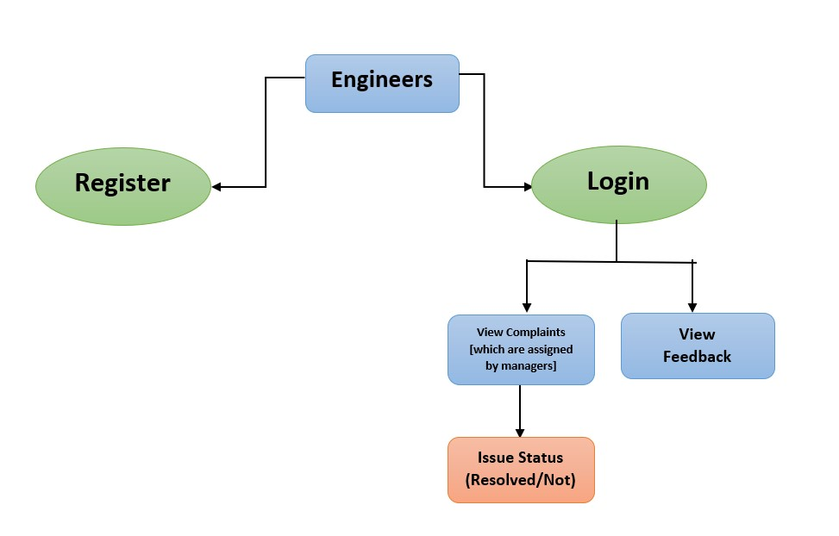
Engineer flowchart
14

Slide 15
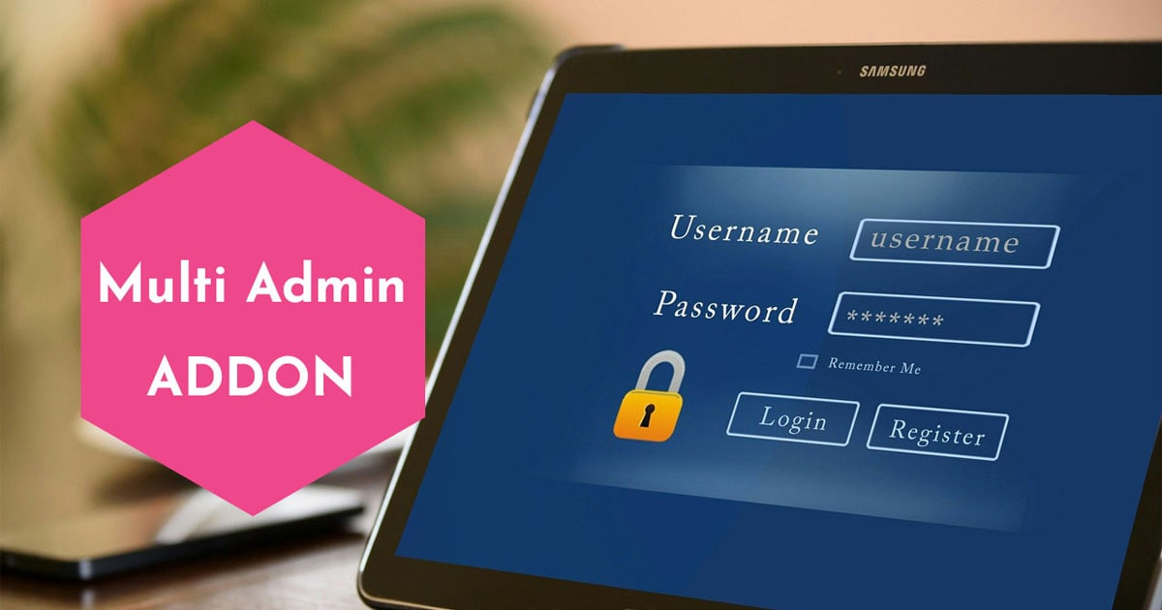
Admin
In this module, the administrator must log in using the credentials; if the credentials are incorrect, a pop-up window will appear.
Once the administrator has provided accurate information, the page will reload.
Administrators can examine customer, manager, engineer, complaints, and feedback after login .
Admin can update or remove complaint ,customer , manager and engineer.

Slide 16
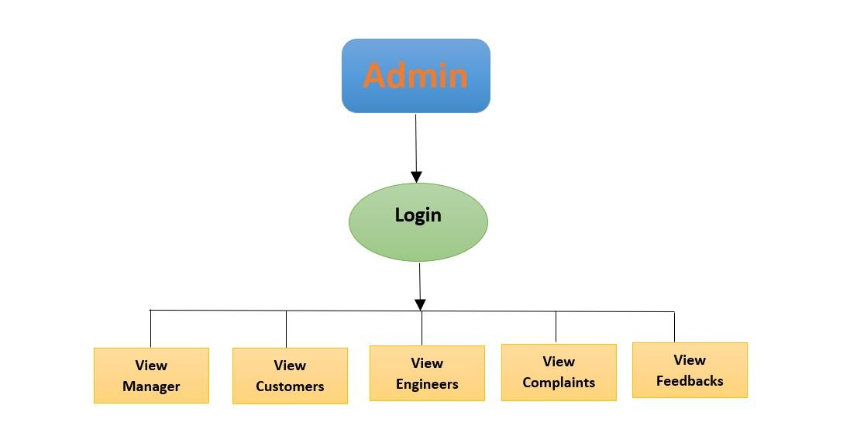
T
Admin Flow-chart
16

Slide 17









Tools And technologies
Front-End: Angular
Server-side: Spring Boot, JPA, Hibernate
Back-end: MYSQL
Web Server: Tomcat

Slide 18


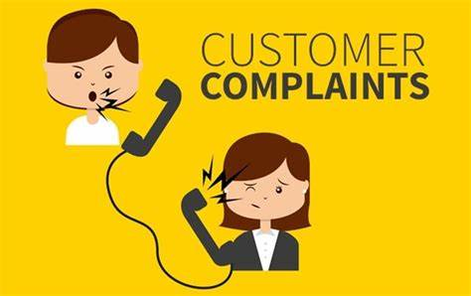




Complaint Redressal System Architecture
Customers
Complaints
Engineers
Managers
Admin

Slide 19

Implementation

Slide 20
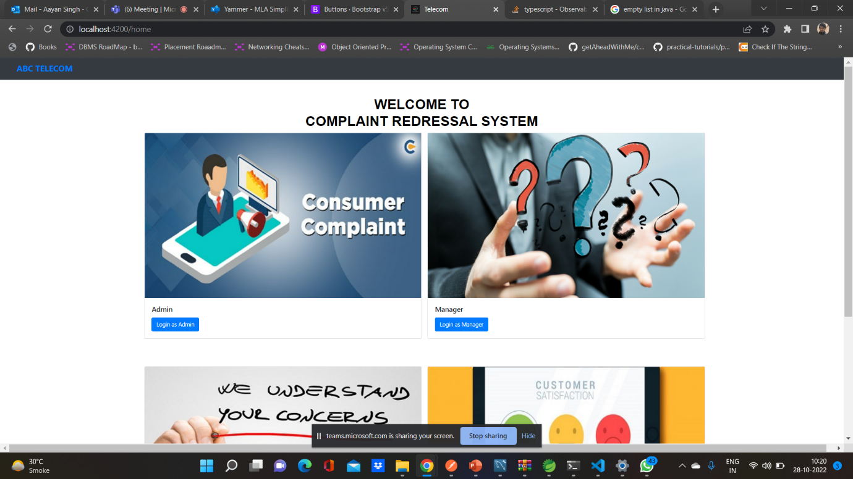
Home

Slide 21
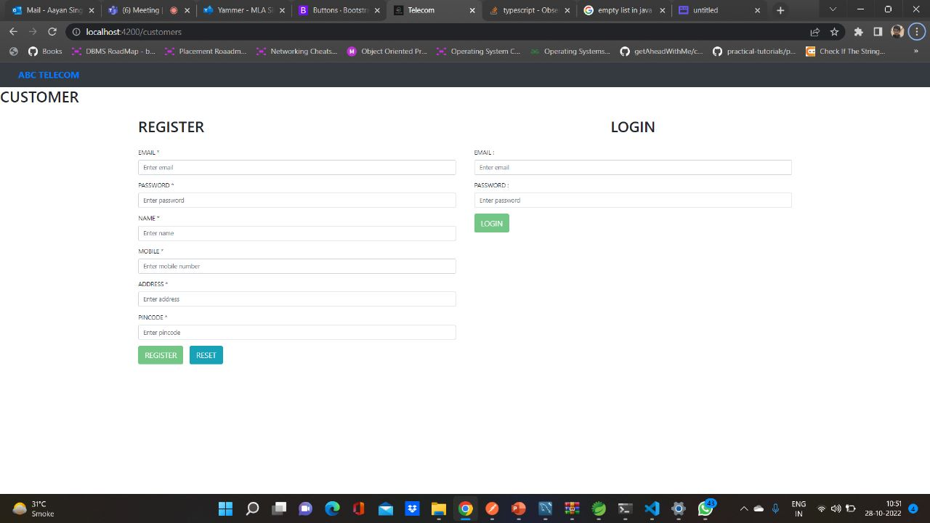
Customer Sign up / Login

Slide 22
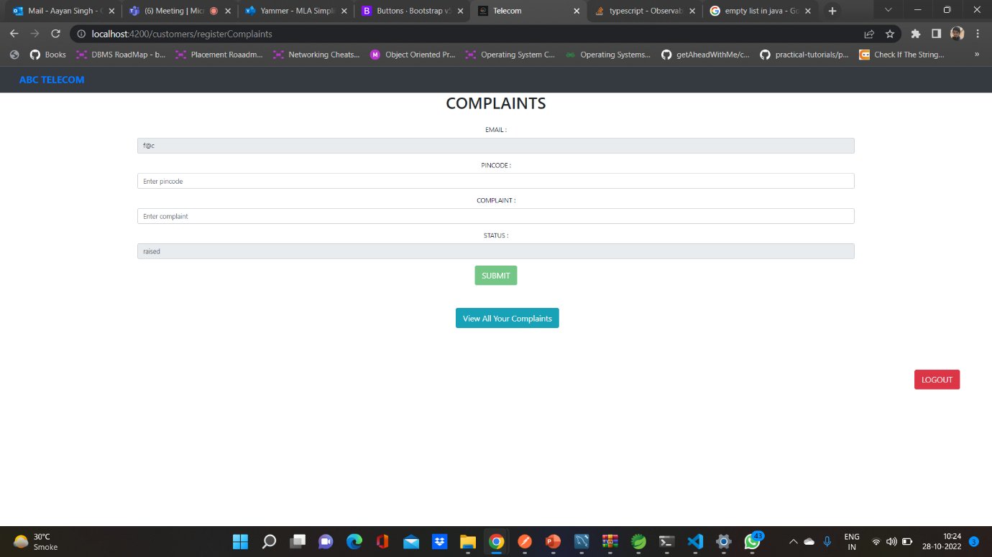
Complaints

Slide 23
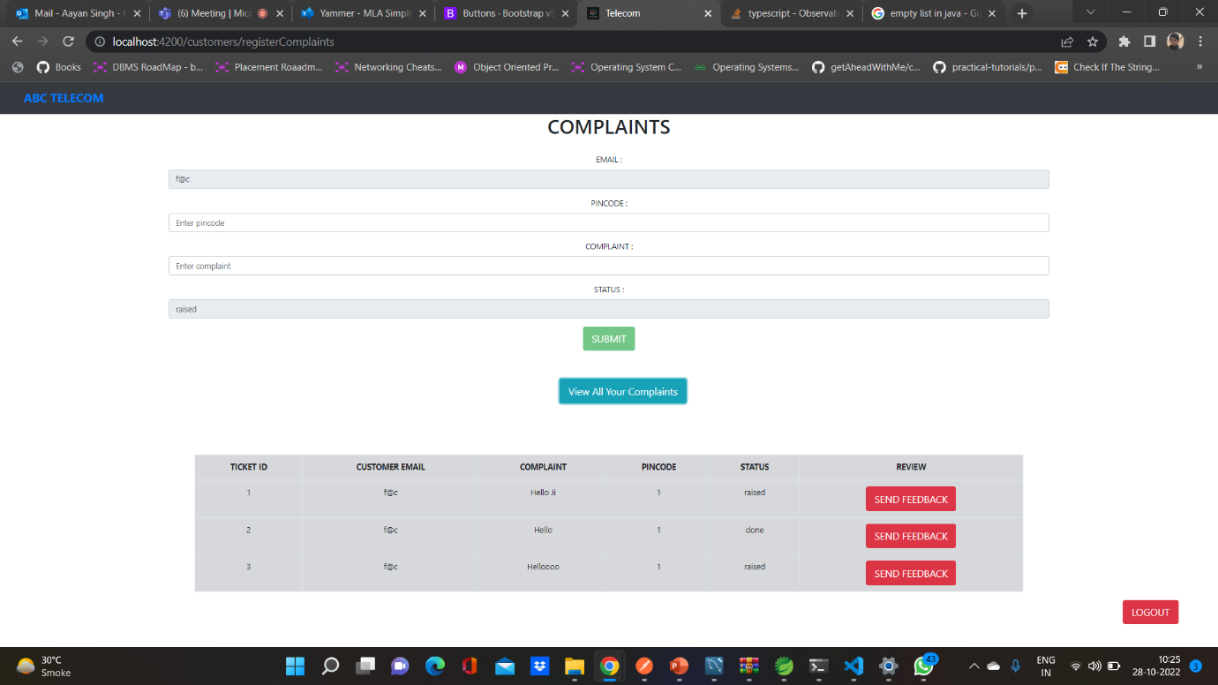
Continue

Slide 24
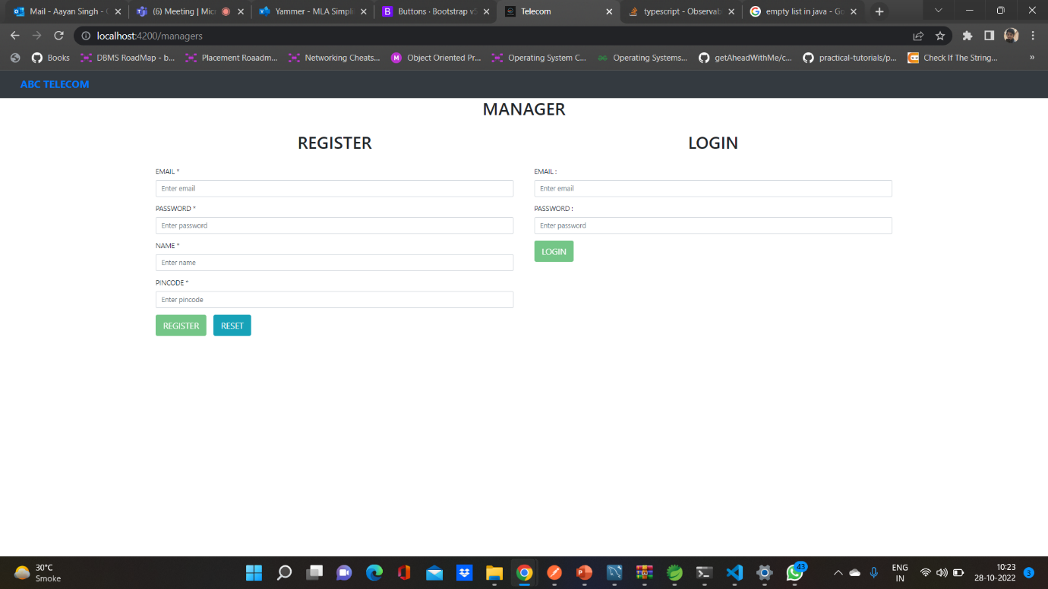
Manager Sing up/sign in

Slide 25
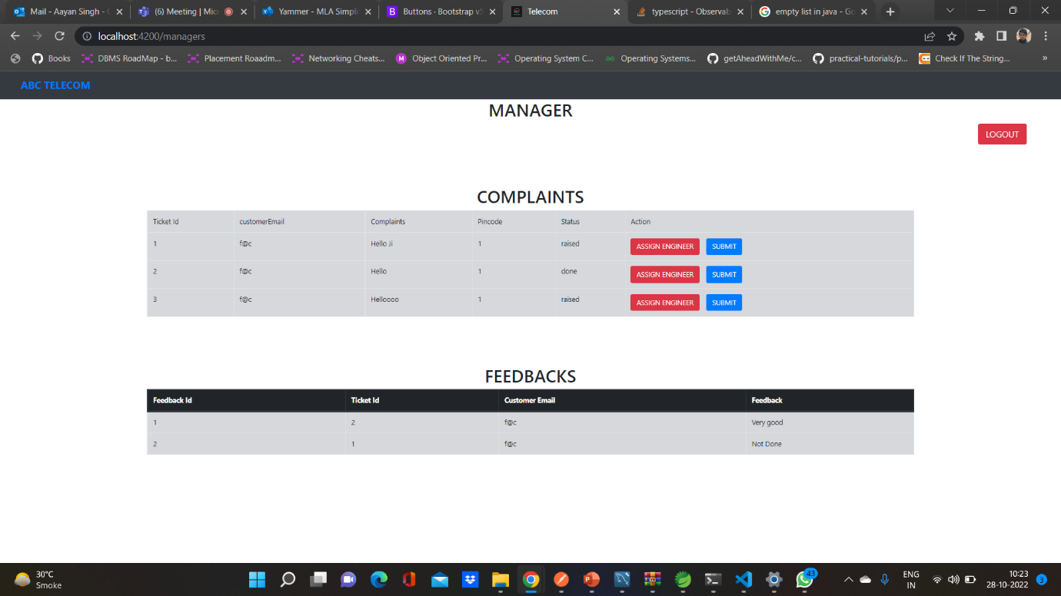
Manager dashboard

Slide 26
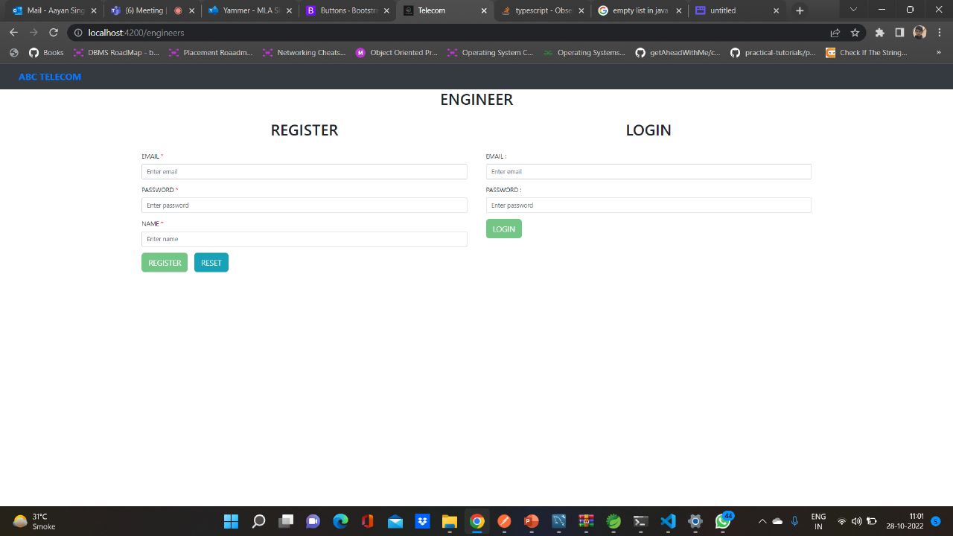
Engineer sign up/sign in

Slide 27
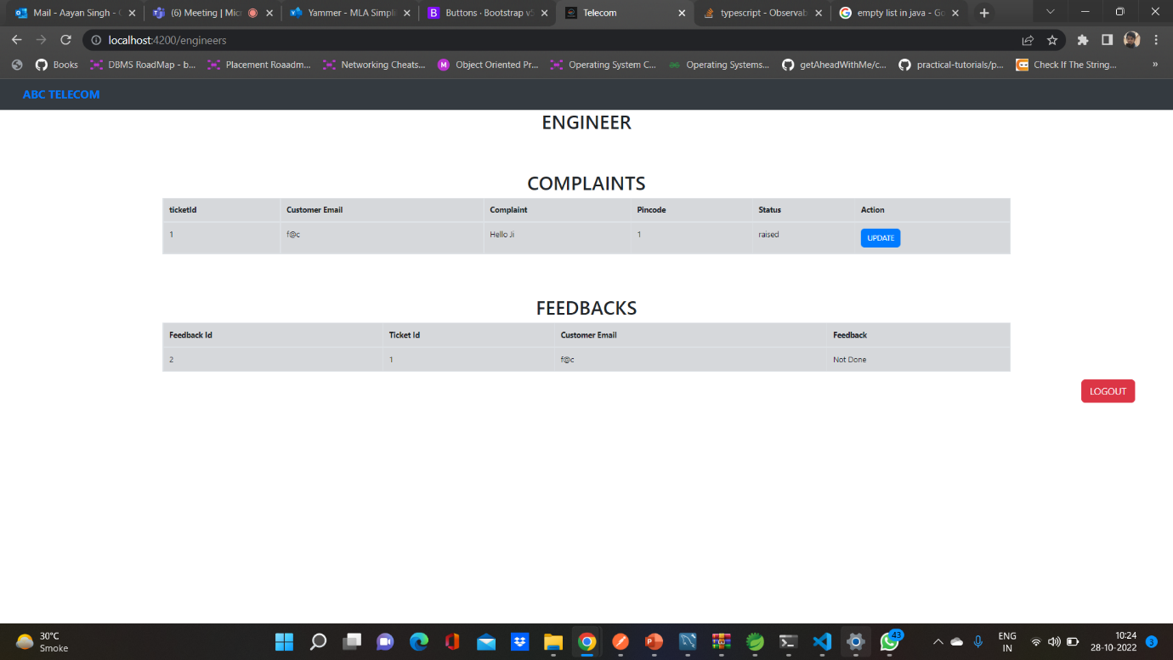
Engineer Dashboard

Slide 28
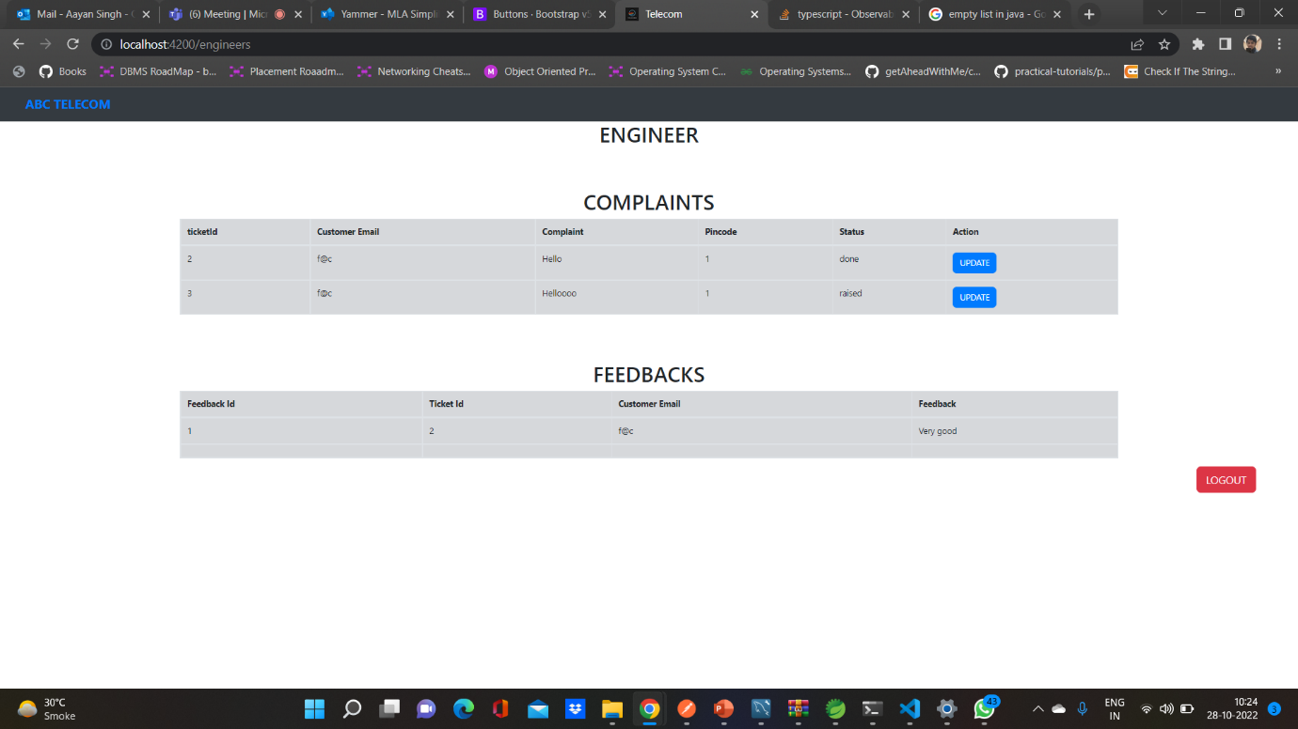
Continue

Slide 29
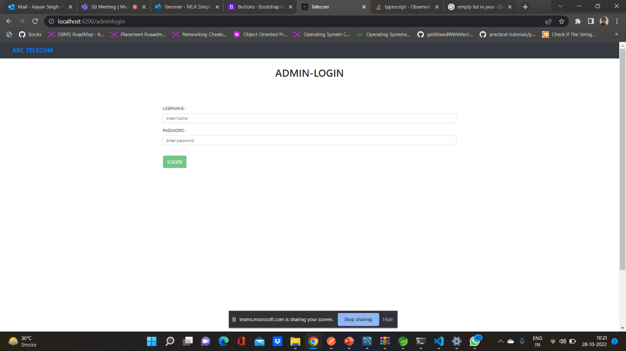
Admin Login

Slide 30
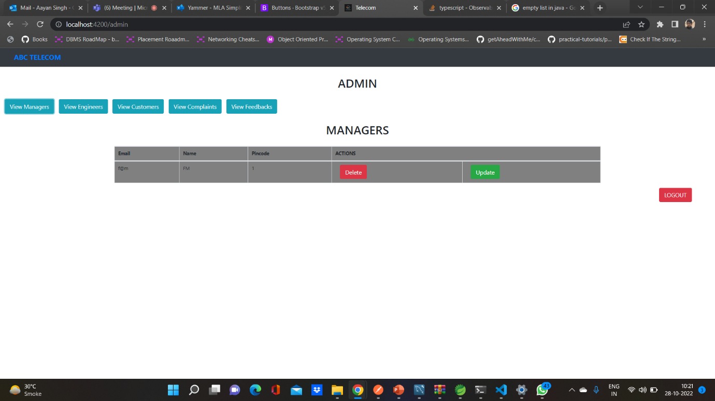
Admin [ Viewing Managers]

Slide 31
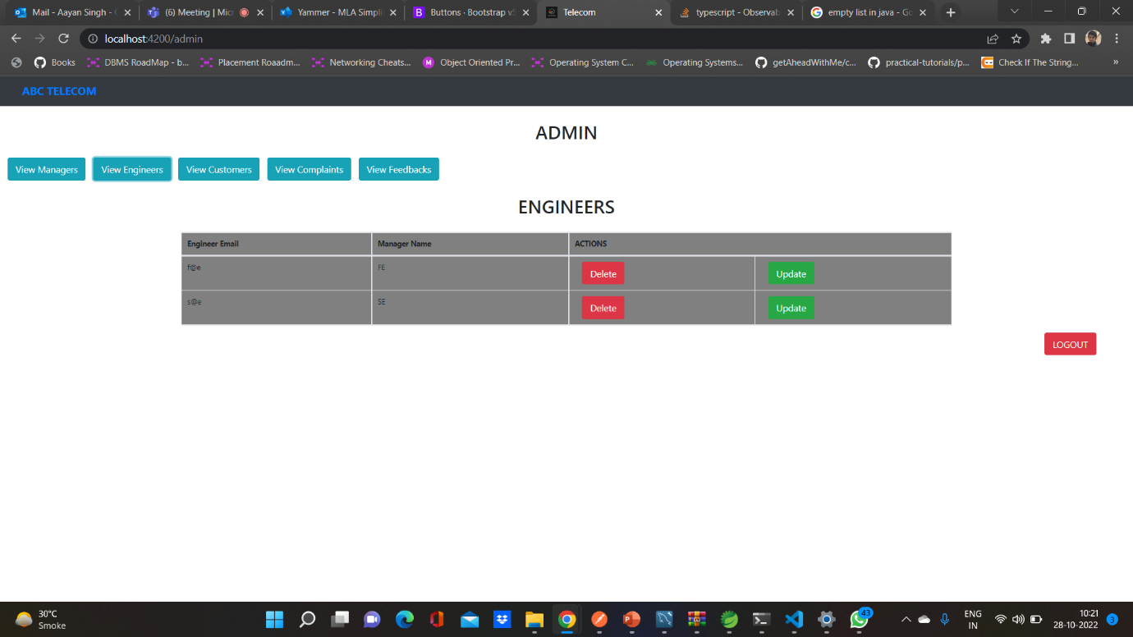
Admin [viewing Engineer]

Slide 32
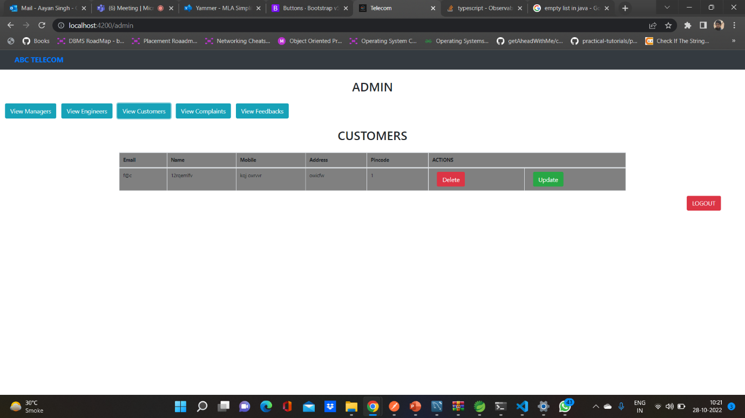
Admin [viewing Customers]

Slide 33
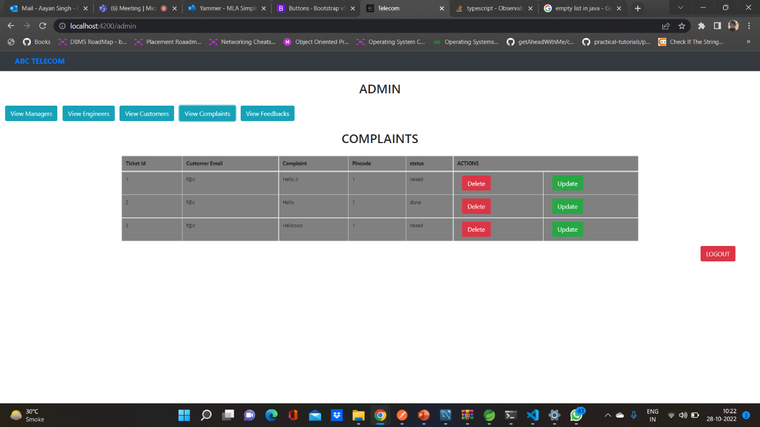
Admin [Viewing Complaints]

Slide 34
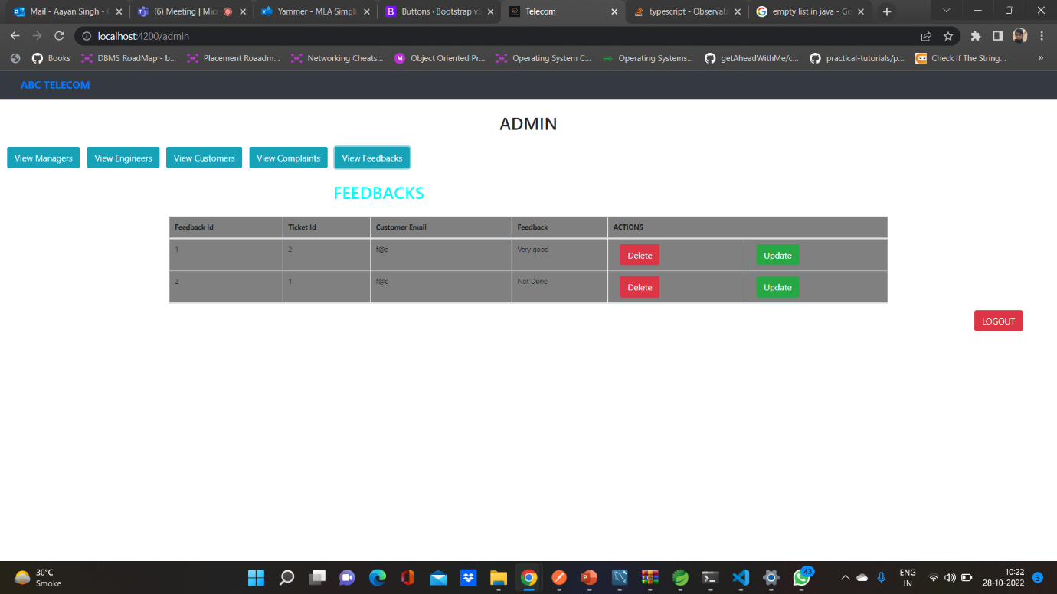
Admin [viewing feedback]

Slide 35
Testing in terms
The IoC (Inversion of Control) container is one of the primary characteristics of the Spring framework. The management of an application's objects is the responsibility of the Spring IoC container. Inversion of control is achieved using dependency injection.
The Spring IoC container is represented by the interfaces Bean Factory and Application Context. The root interface for gaining access to the Spring container in this case is Bean Factory.
It offers the most fundamental bean management features.
The Application Context, on the other hand, is a sub-interface of the Bean Factory.

Slide 36
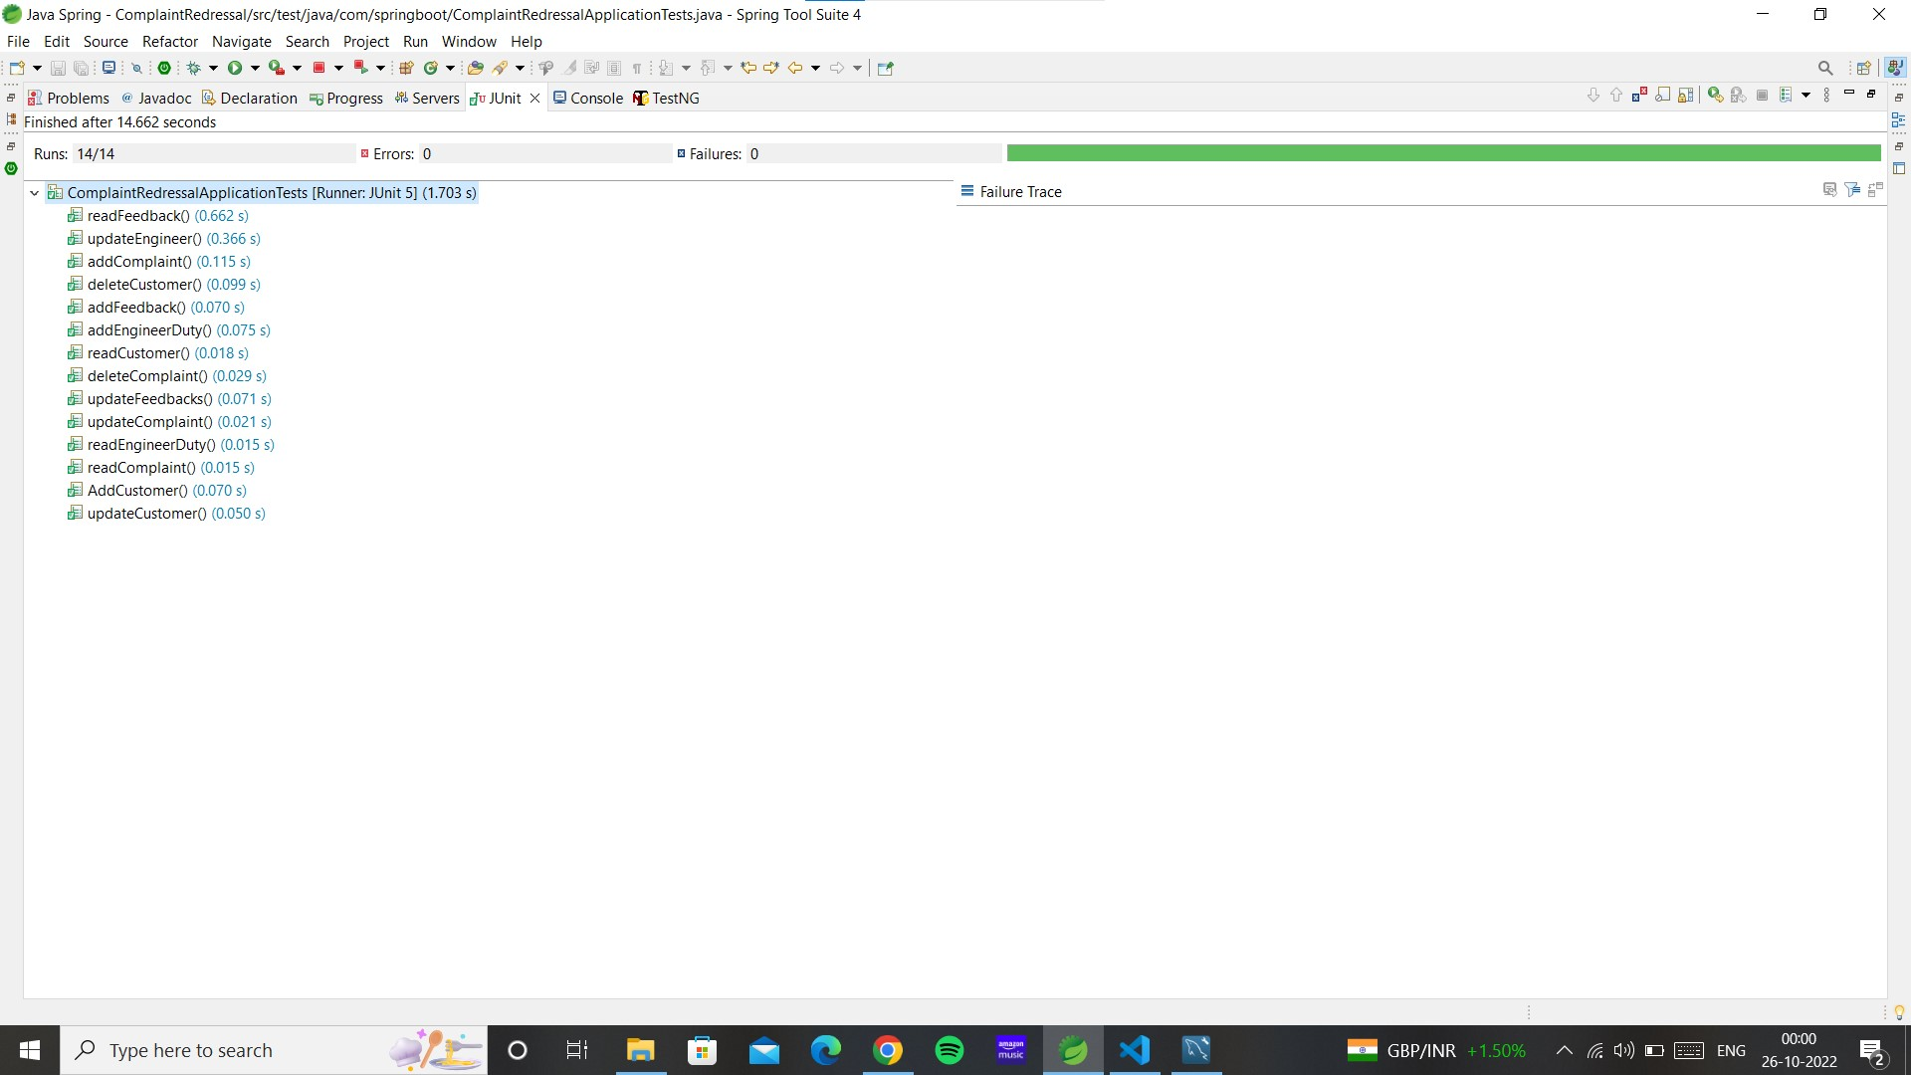
J unit testing

Slide 37


